Slide 1

Azure Cloud, Terraform and Azure DevOps
- Benitha Gadupudi

Slide 2
Azure
Cloud Service provided by Microsoft.
Azure cloud platform is more than 200 products and cloud services designed to help you bring new solutions to life.
Shared responsibility model.
Cloud Models.
Consumption based model.

Slide 3
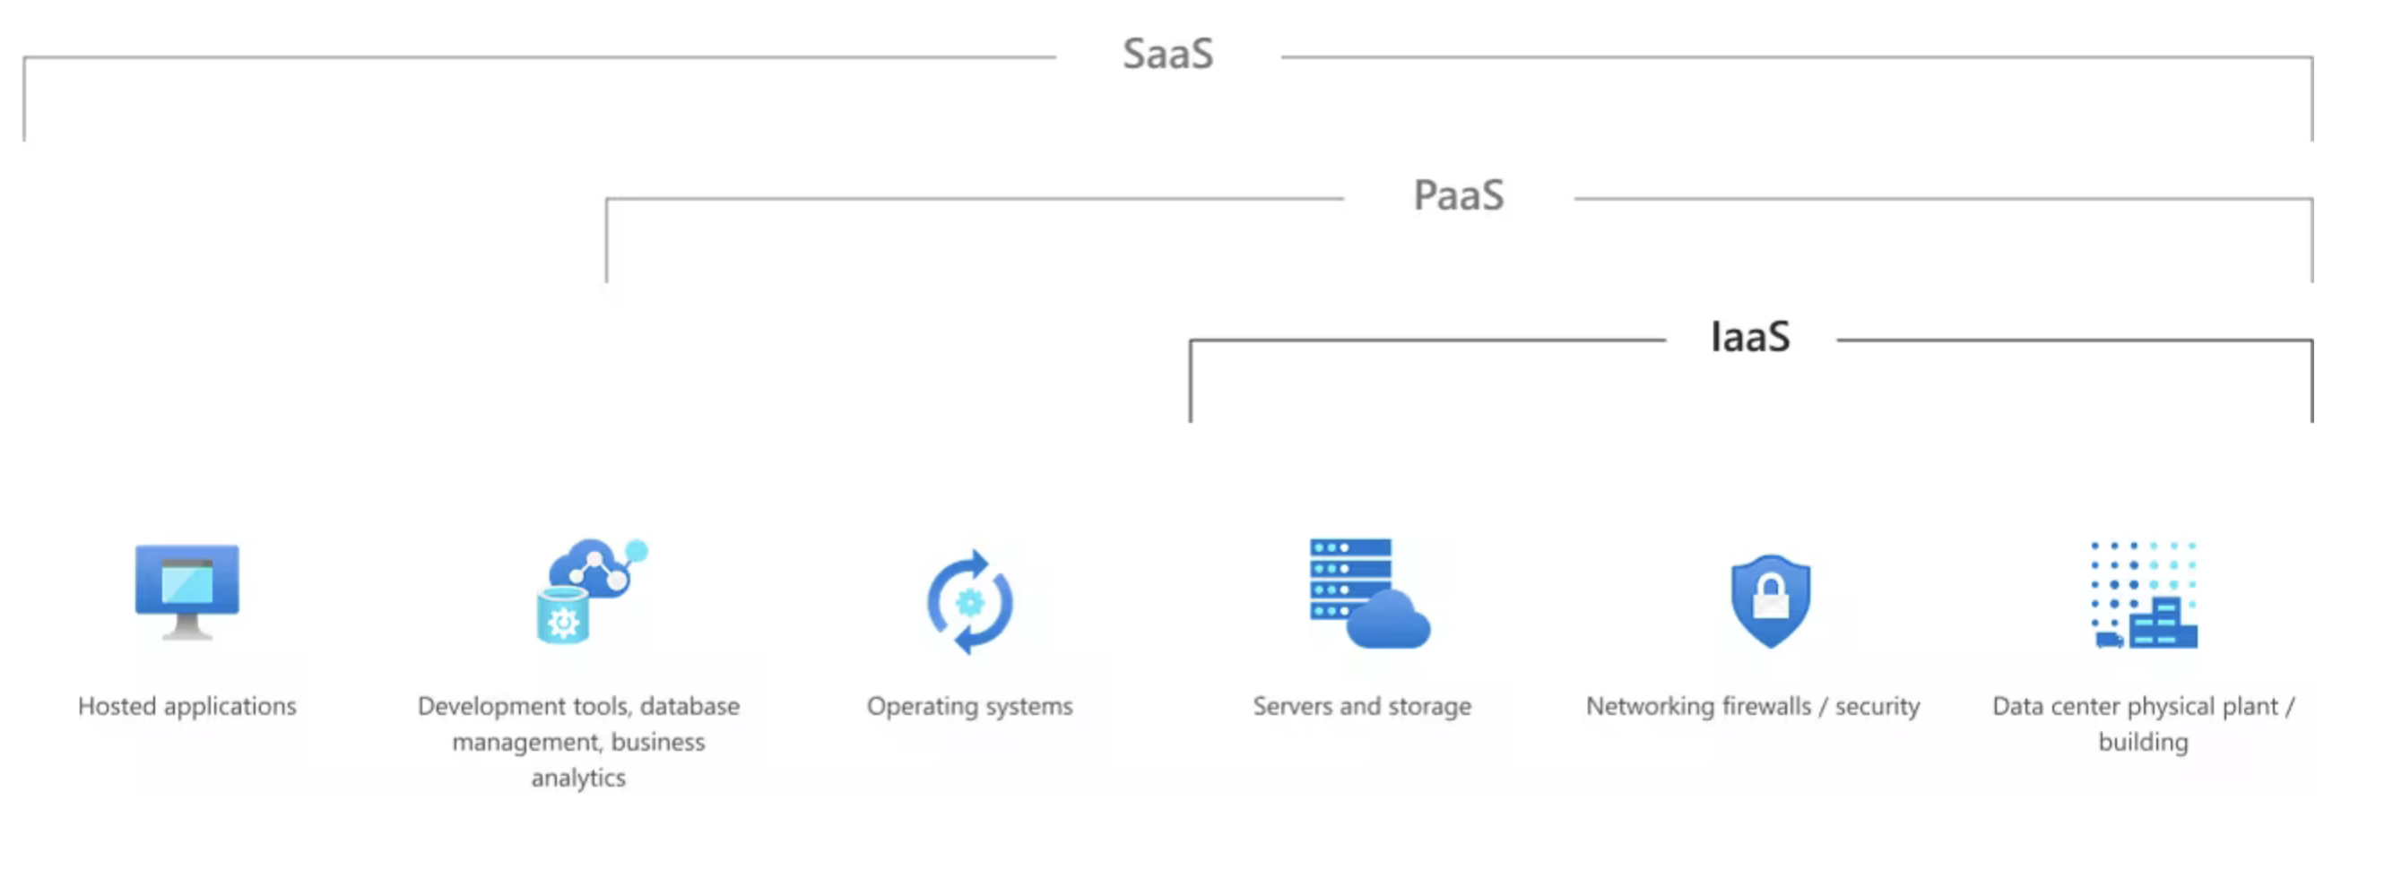
Shared Responsibility Model

Slide 4
Benefits of using cloud
High Availability and Scalability.
Reliability and Predictability.
Security and Governance.
Manageability.

Slide 5
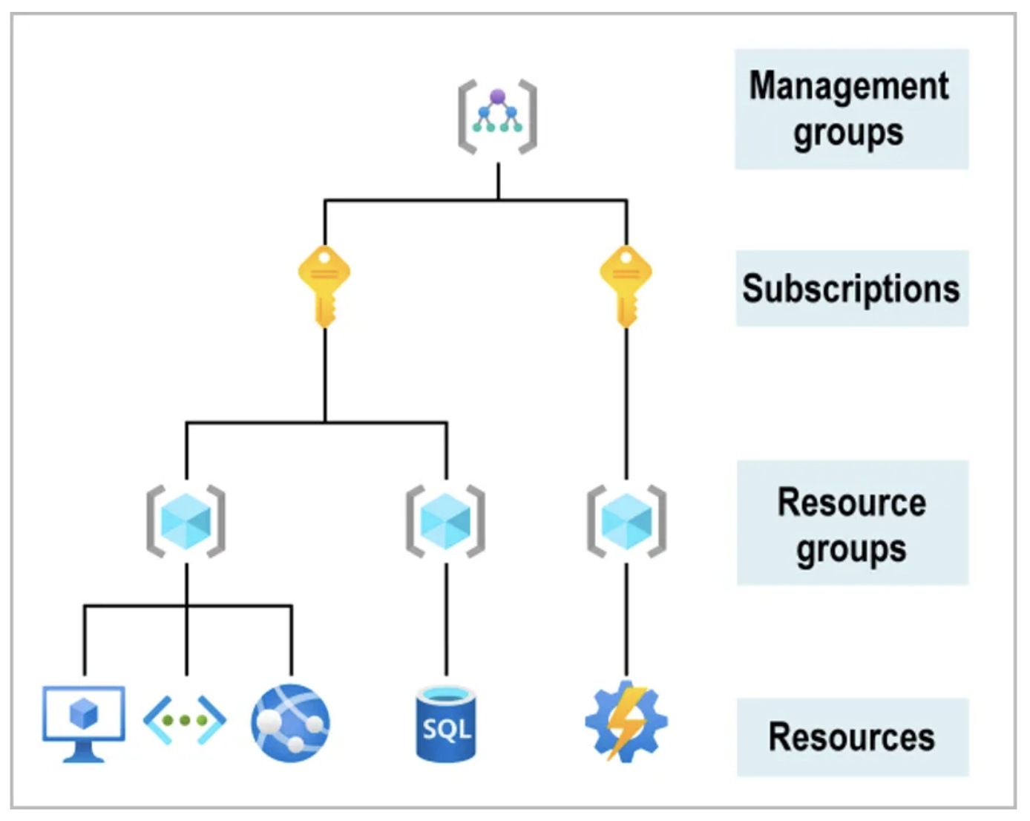
Azure Resource Hierarchy

Slide 6
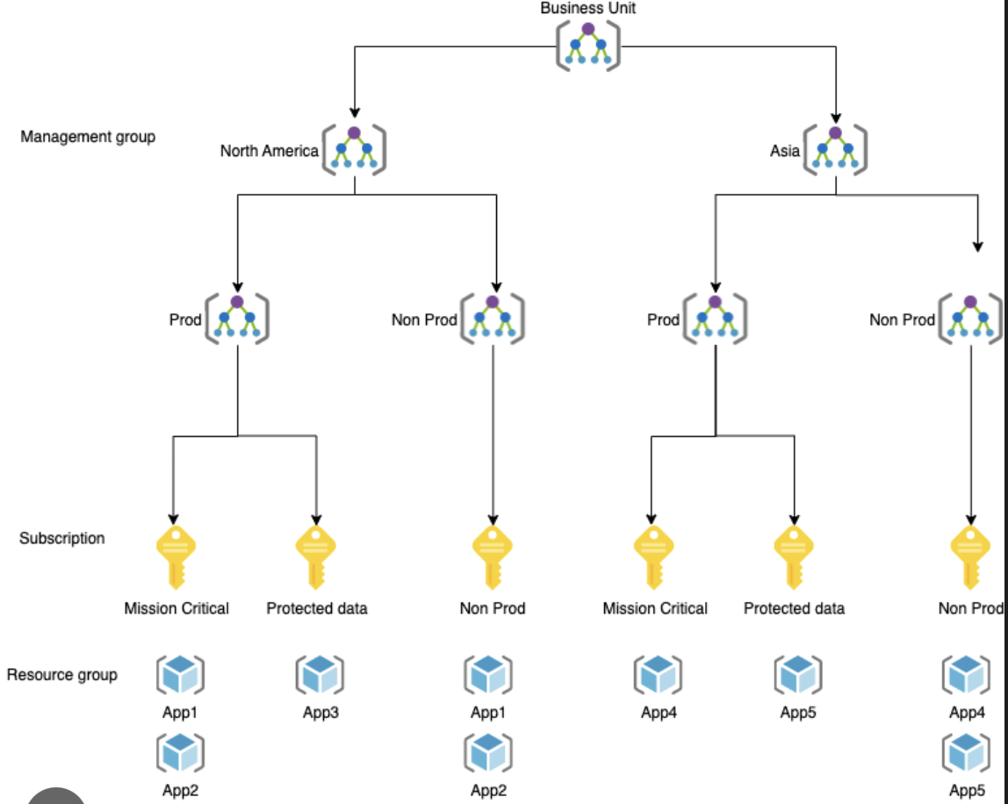
Hierarchy Example

Slide 7
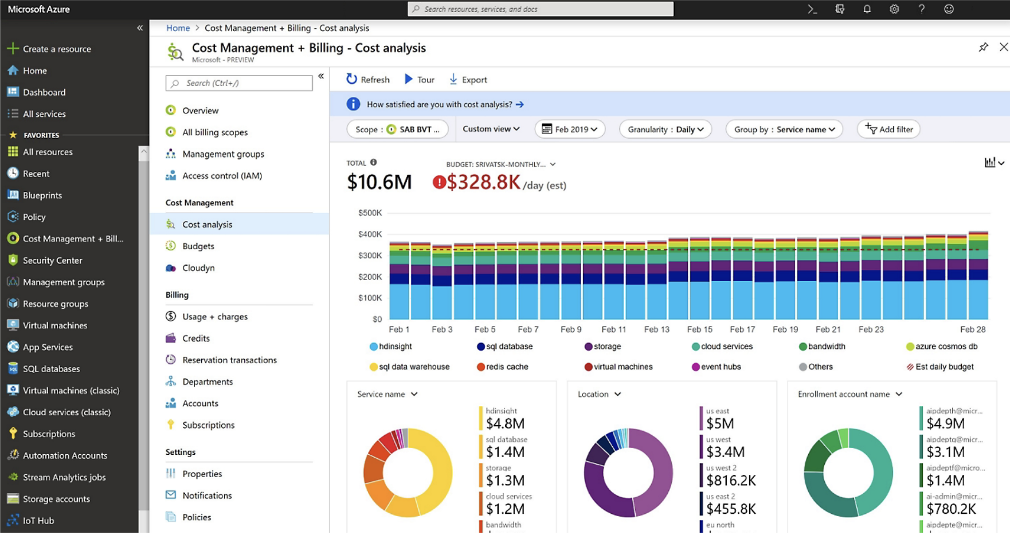
Cost Analysis

Slide 8
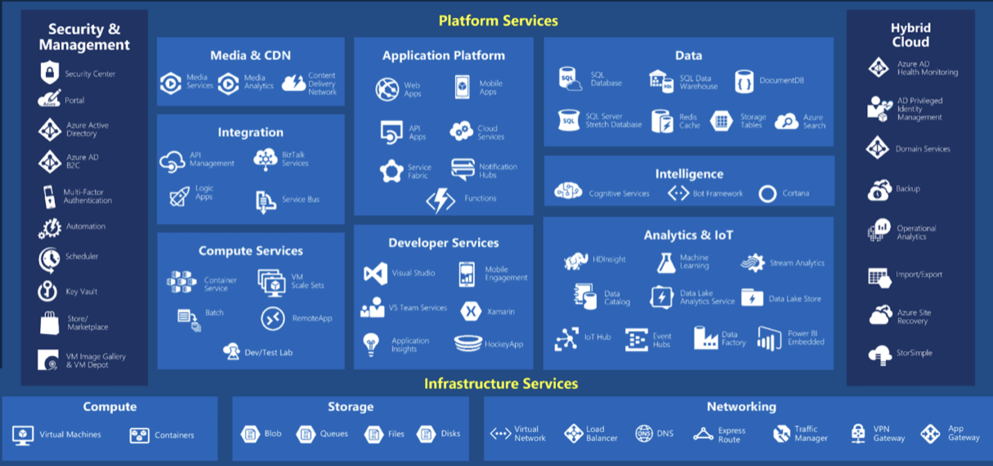

Slide 9
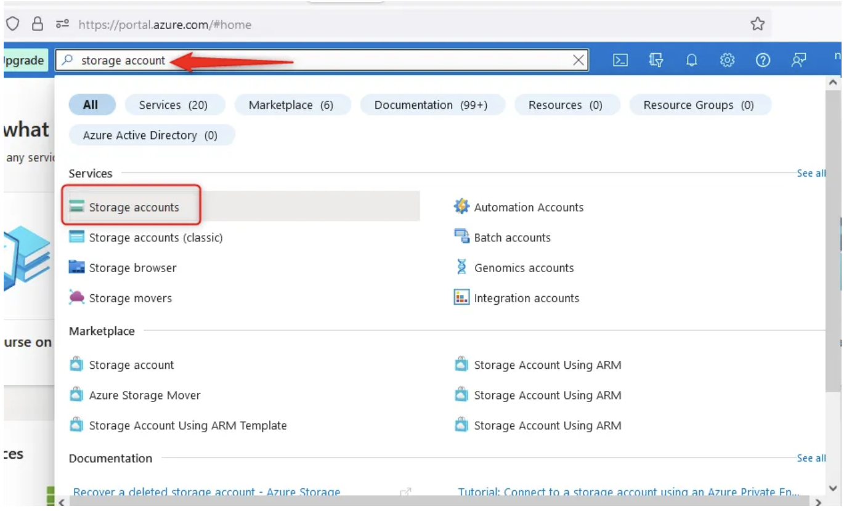
Creating a Storage Account in Azure

Slide 10
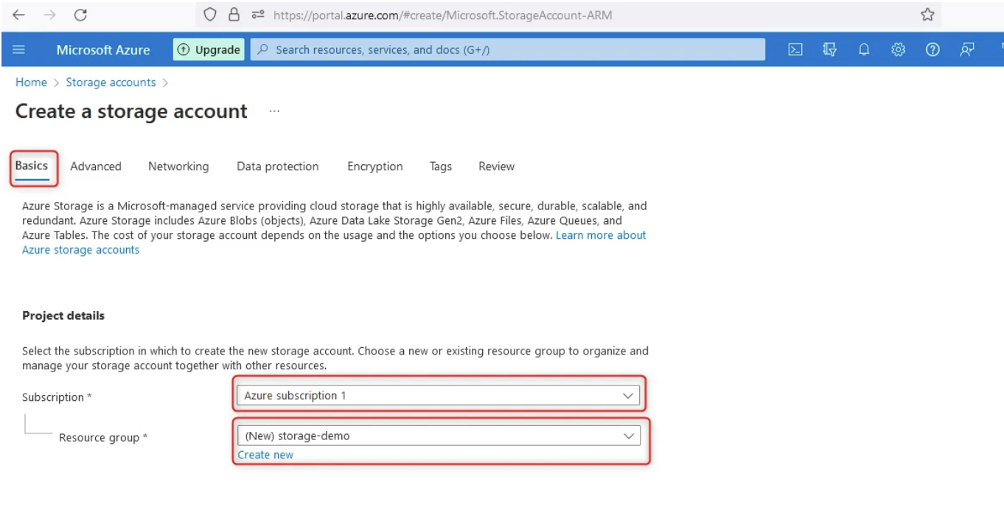
Storage Account in Azure

Slide 11
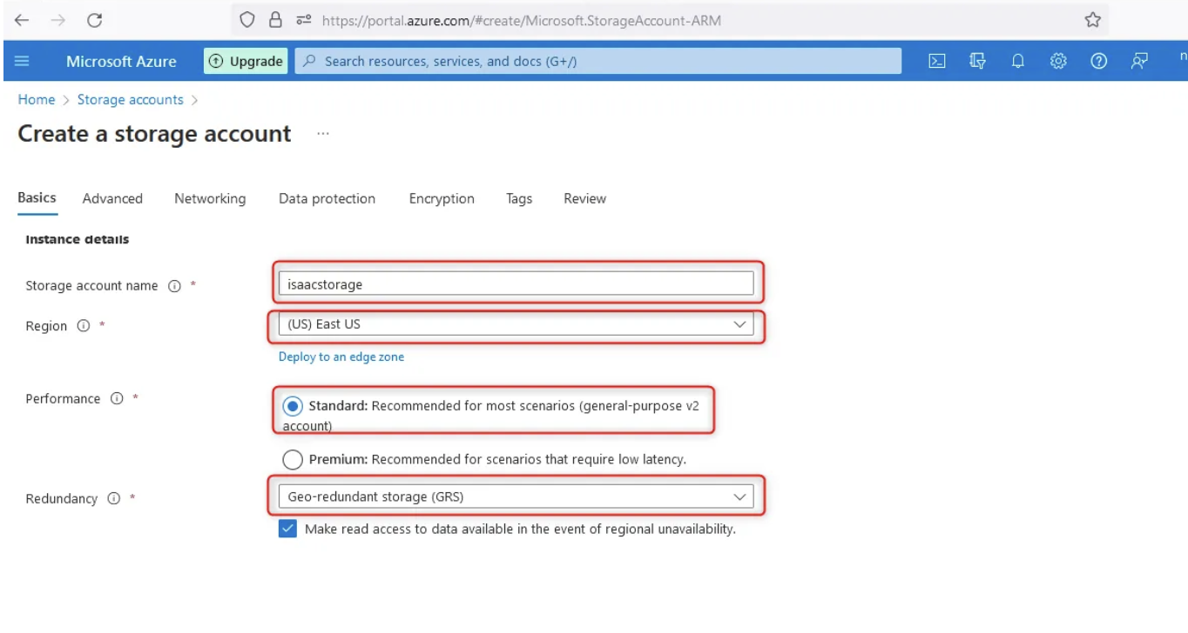
Storage Account in Azure

Slide 12
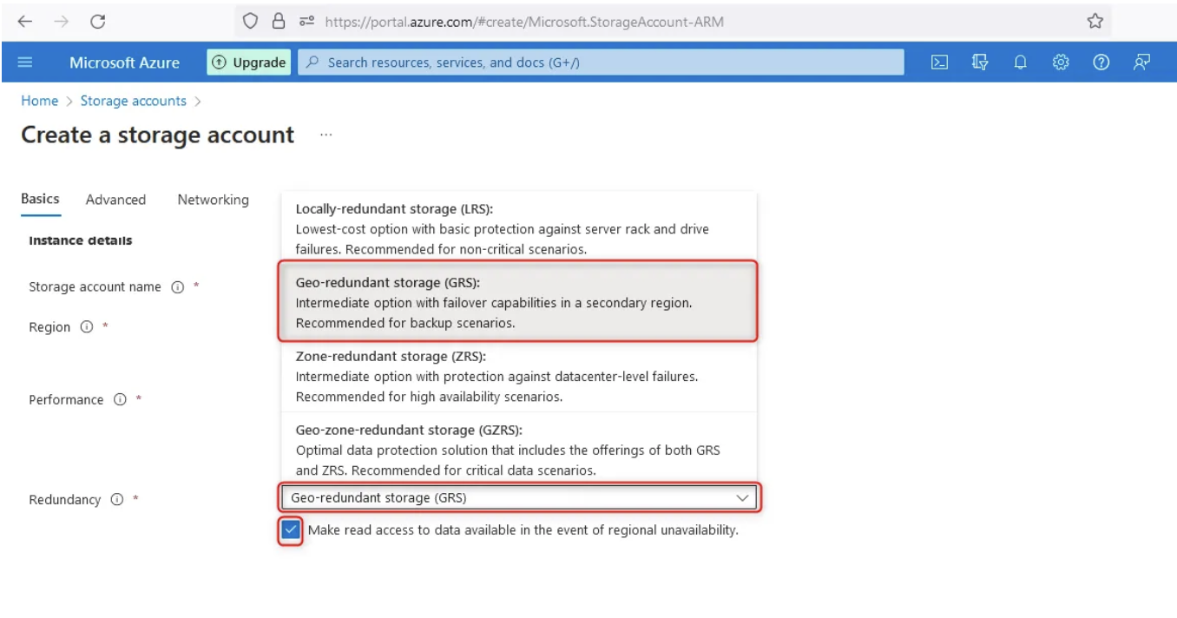
Storage Account in Azure

Slide 13
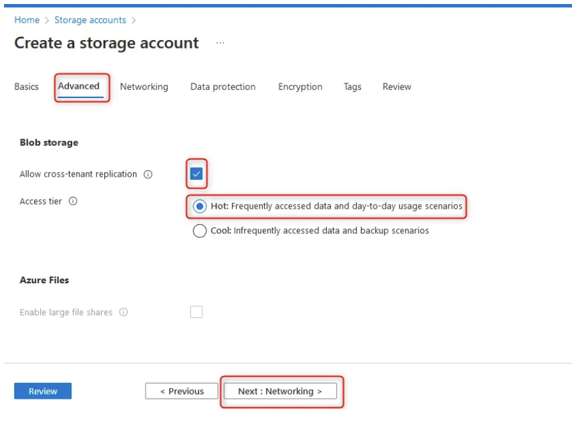
Storage Account in Azure

Slide 14
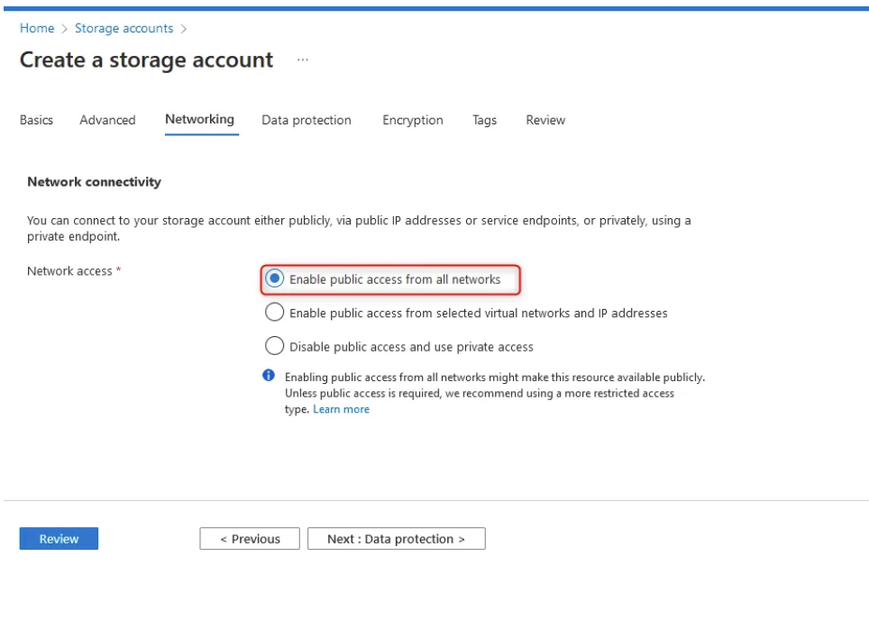
Storage Account in Azure

Slide 15
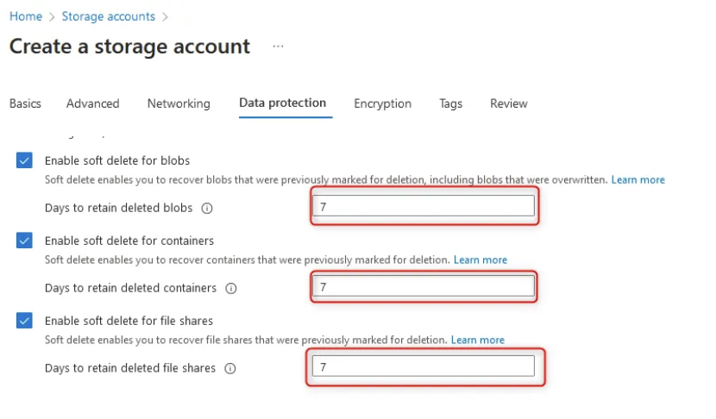
Storage Account in Azure

Slide 16
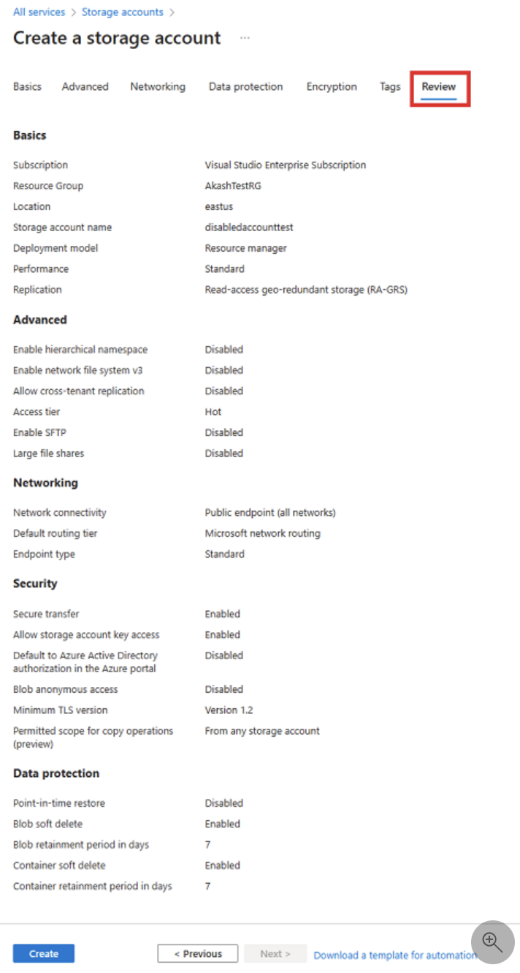
Storage Account in Azure

Slide 17
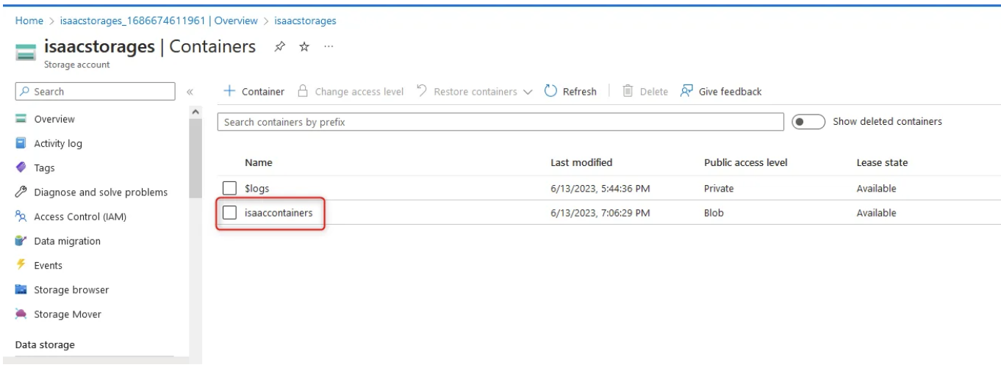
Storage Account in Azure

Slide 18
Creating Azure Resources
Portal
Azure CLI
PowerShell
Terraform
Bicep
ARM Template

Slide 19

Terraform
Infrastructure as Code (IaC) tool by HashiCorp.
IaC allows you to build, change, and manage your infrastructure in a safe, consistent, and repeatable way by defining resource configurations that you can version, reuse, and share.

Slide 20
Terraform
Install, Build, Change
Commands
terraform init
terraform plan
terraform validate
terraform apply
terraform destroy

Slide 21
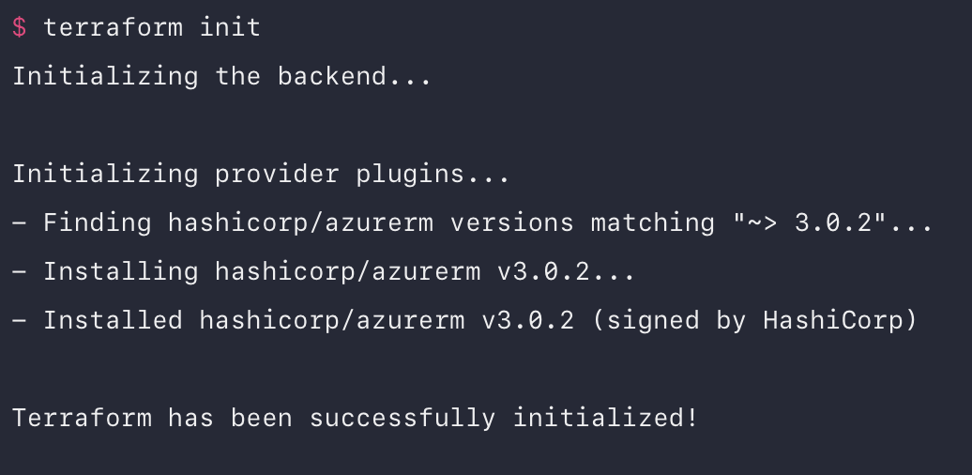
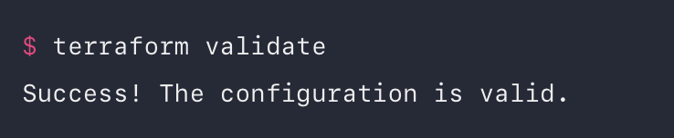
Terraform Init and Validate

Slide 22
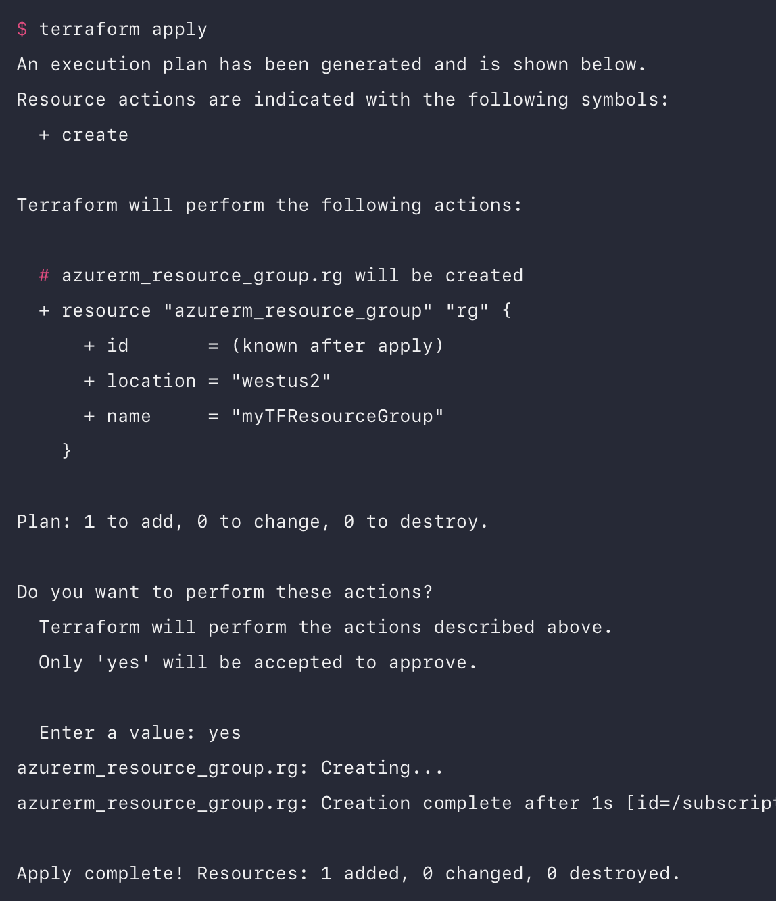
Terraform Plan and Apply

Slide 23
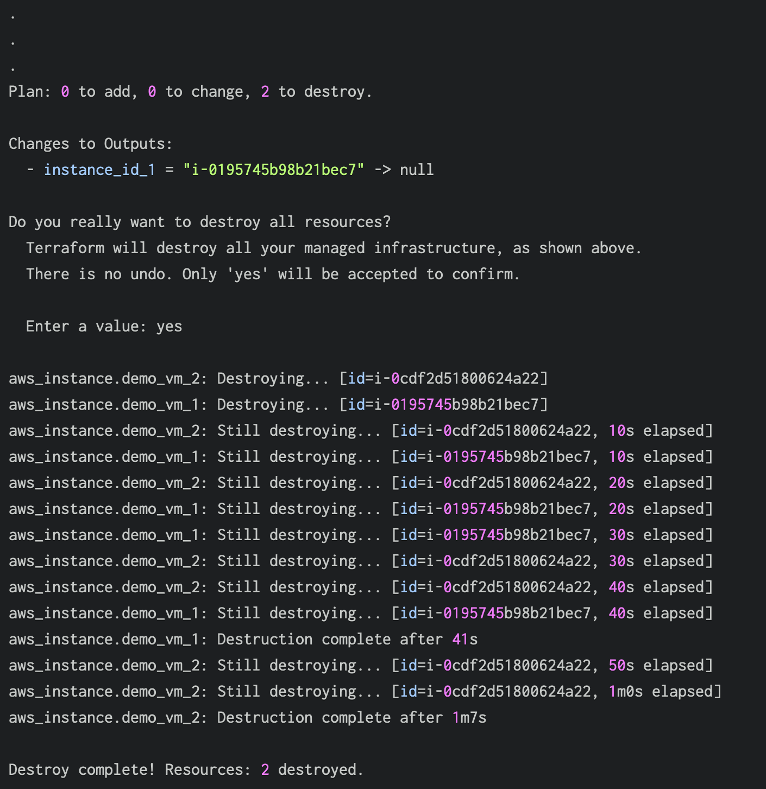
Terraform Destroy

Slide 24
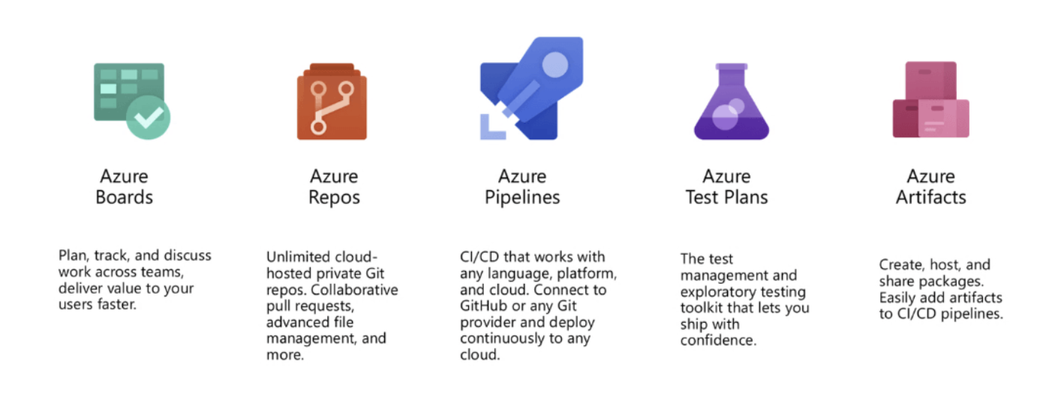
Azure DevOps

Slide 25
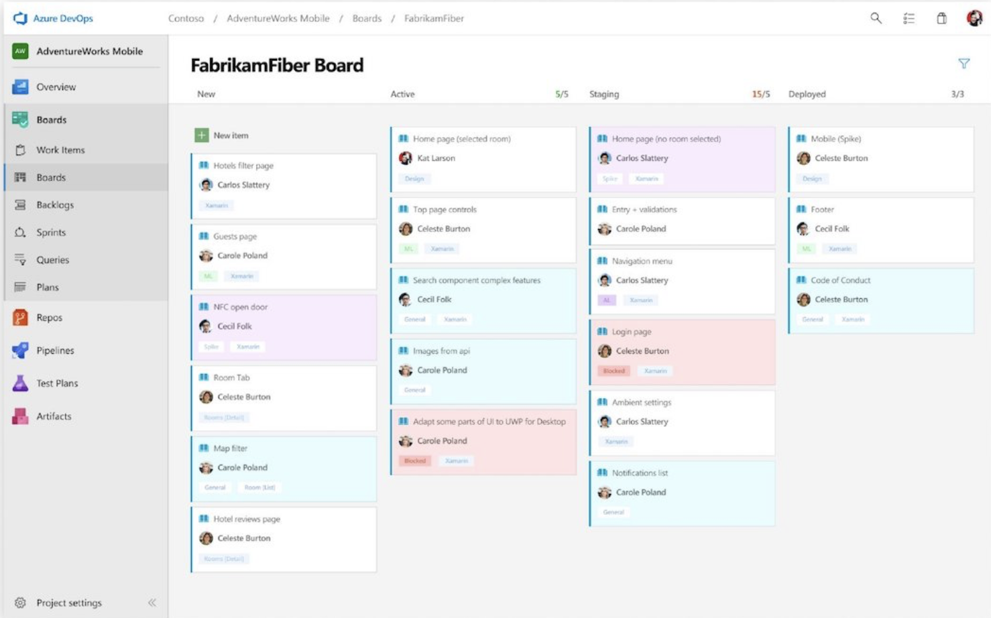
Azure Boards

Slide 26
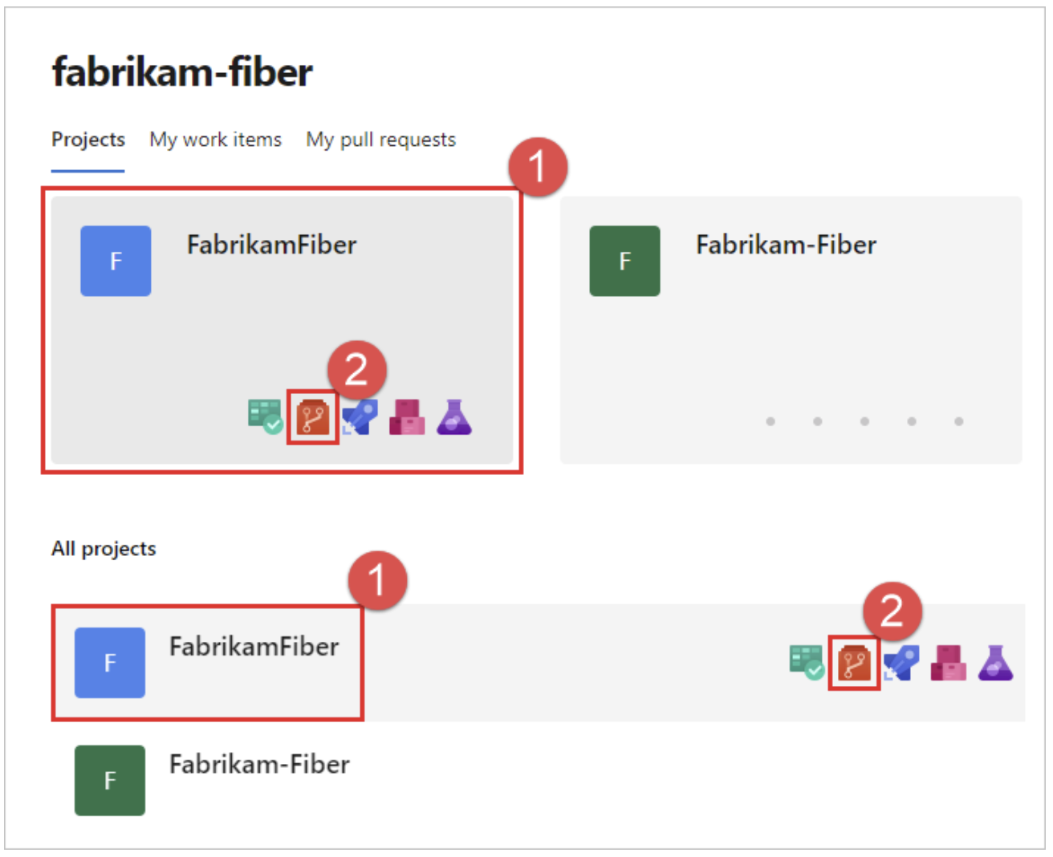
Azure Repo

Slide 27
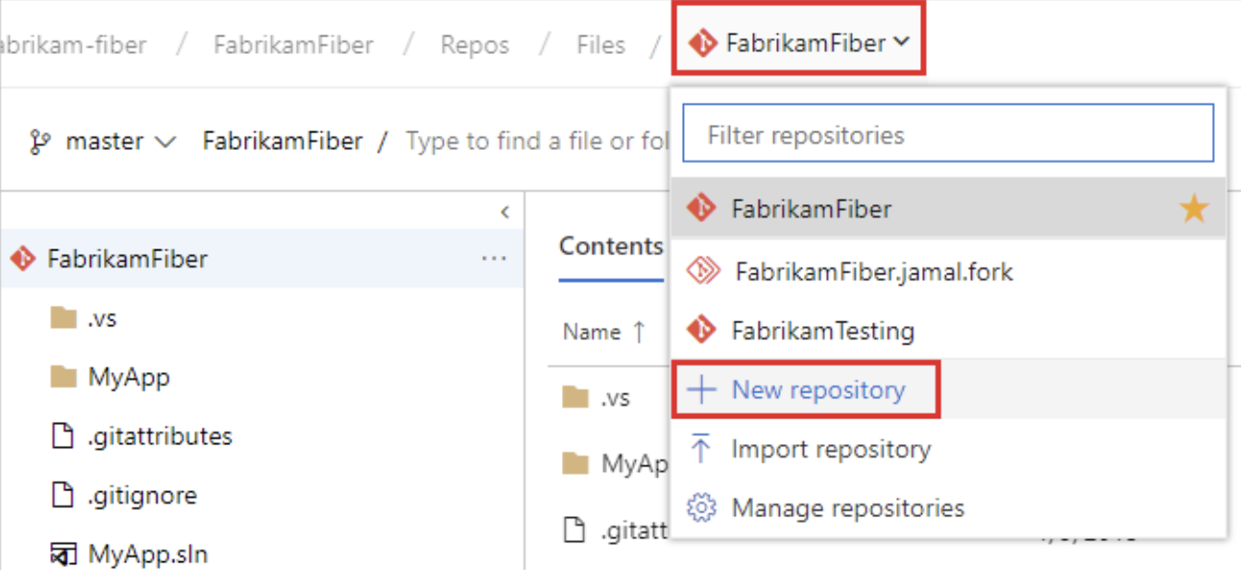
Azure Repo

Slide 28
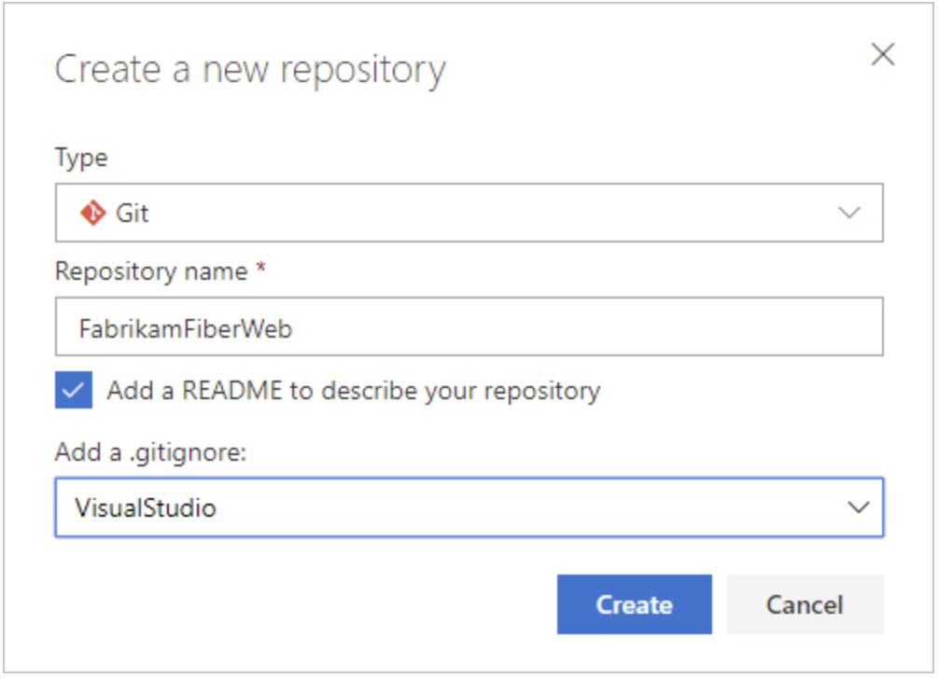
Azure Repo

Slide 29
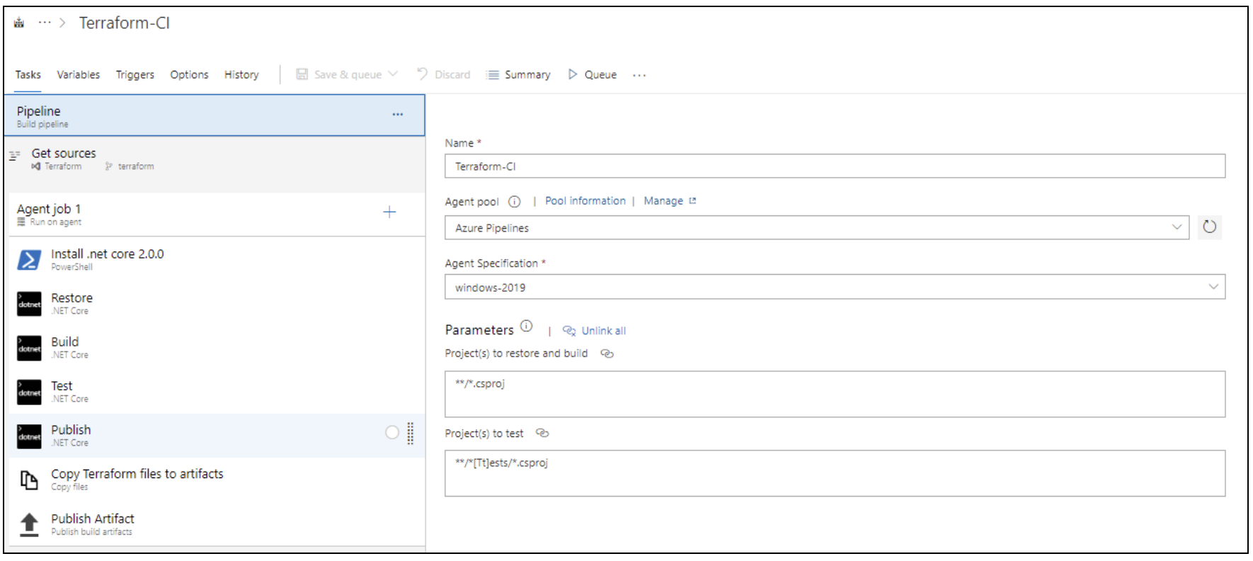
Azure Pipeline – CI/CD setup

Slide 30
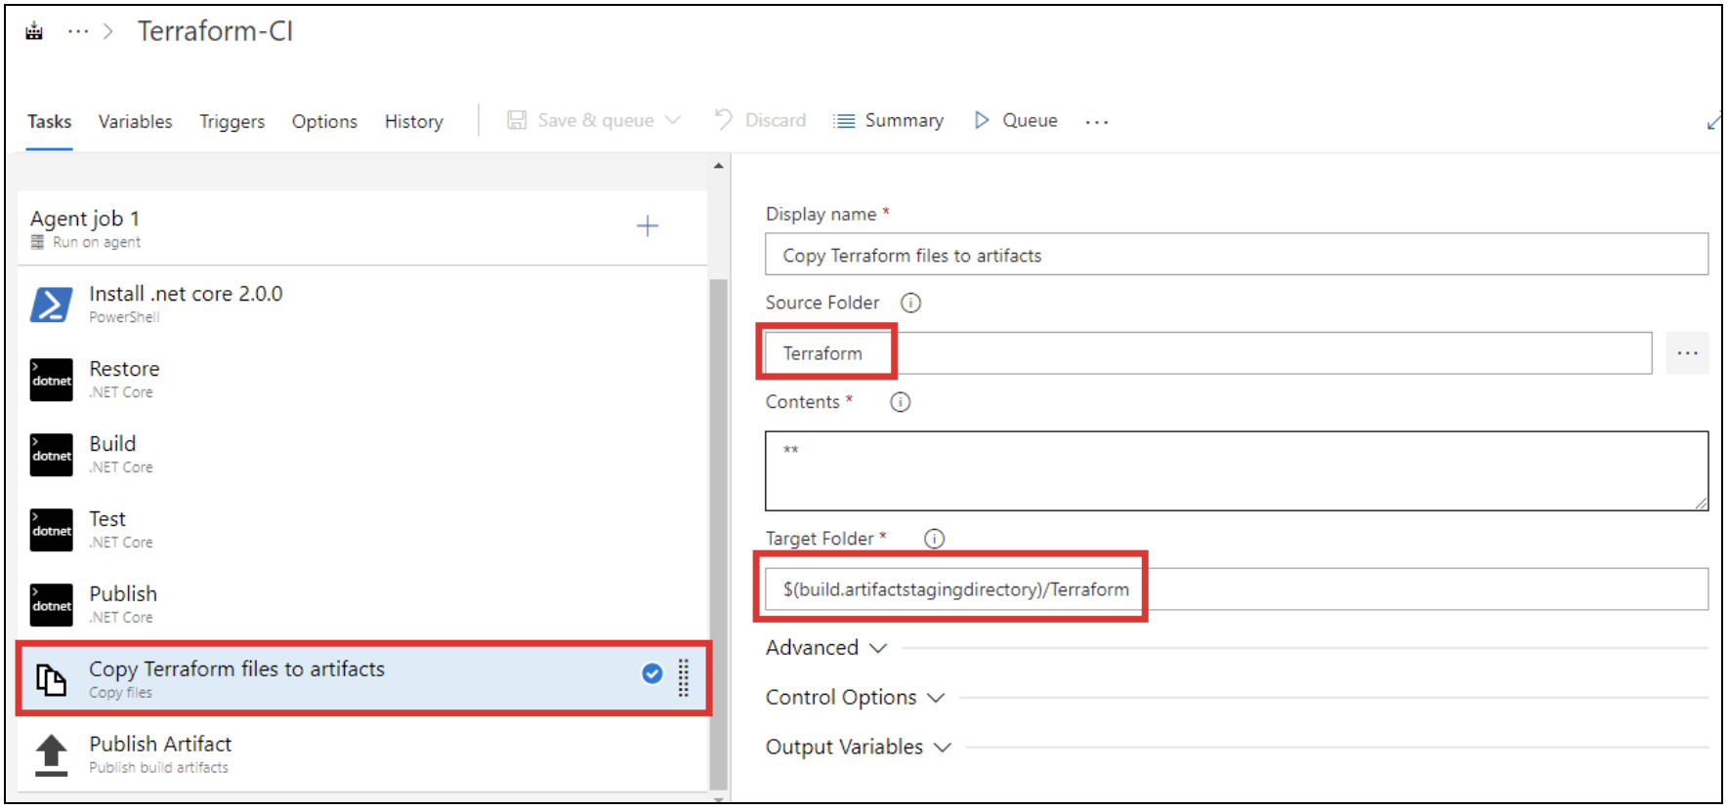
Azure Pipeline – CI/CD setup

Slide 31
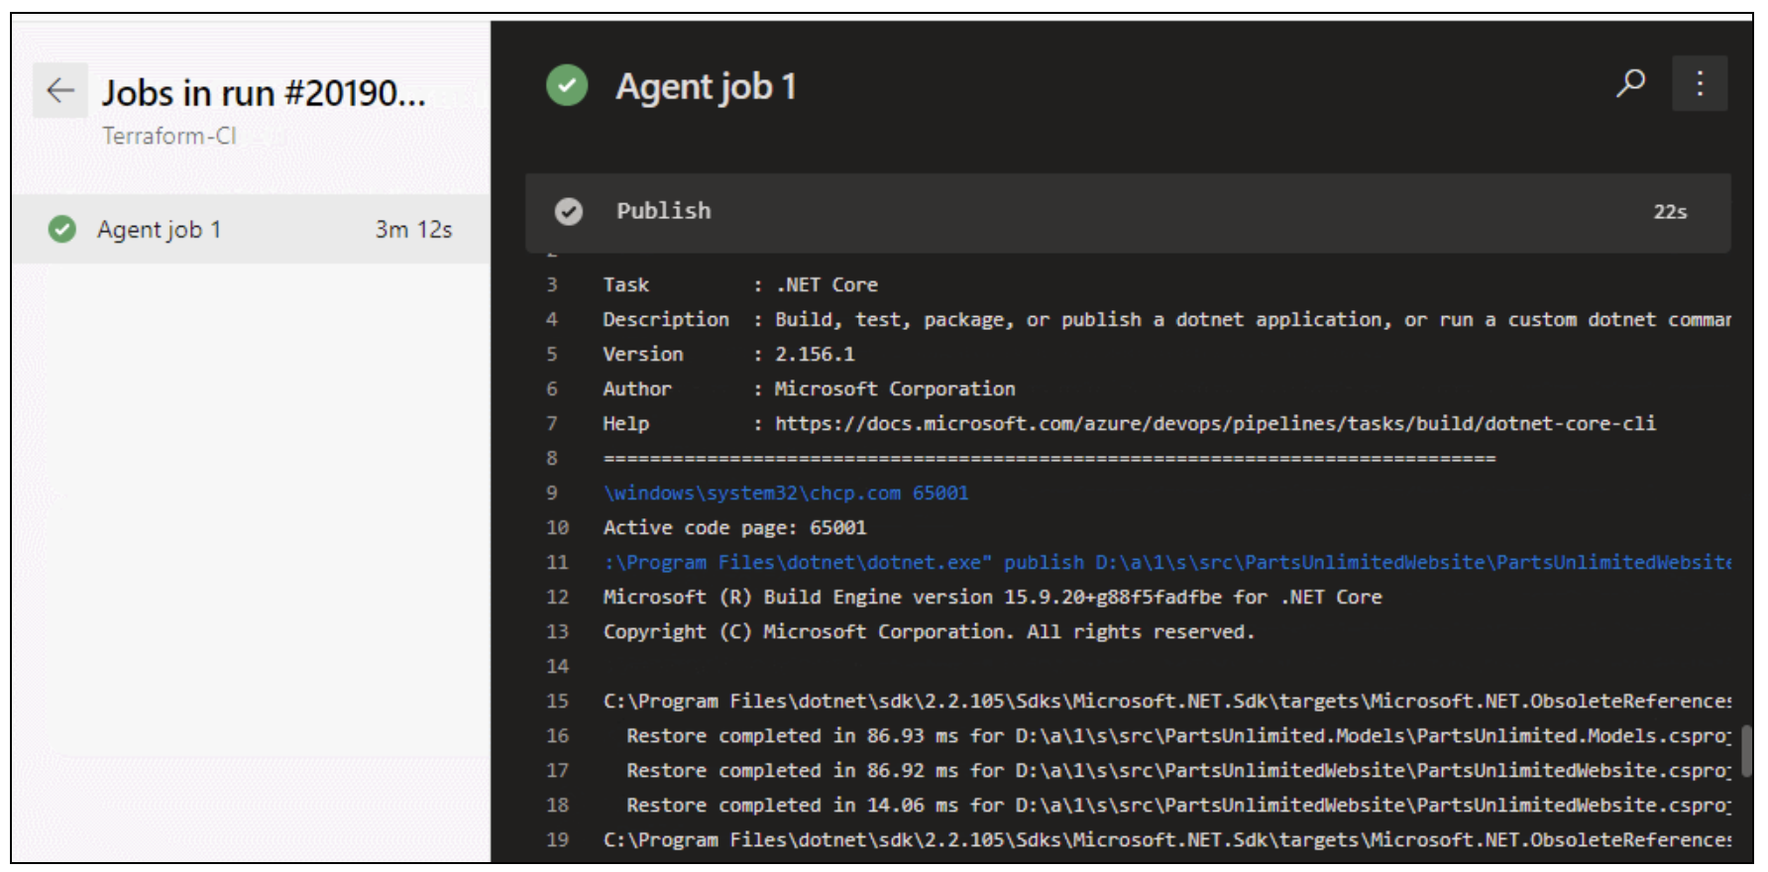
Azure Pipeline – CI/CD setup

Slide 32
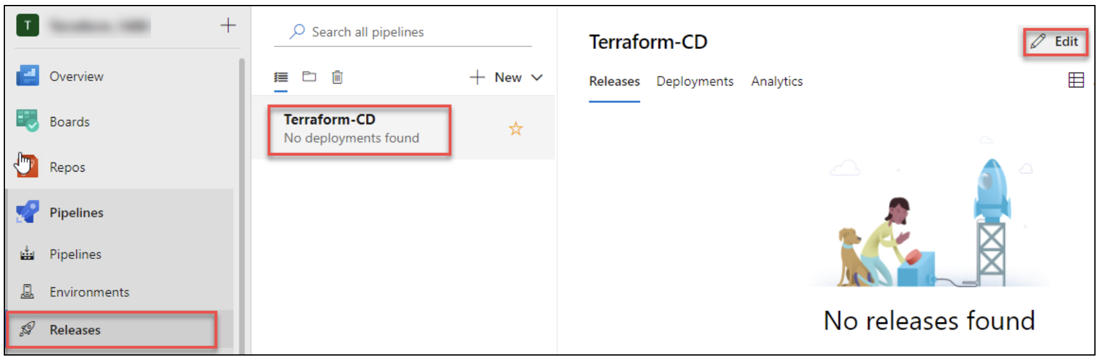
Azure Pipeline – CI/CD setup

Slide 33
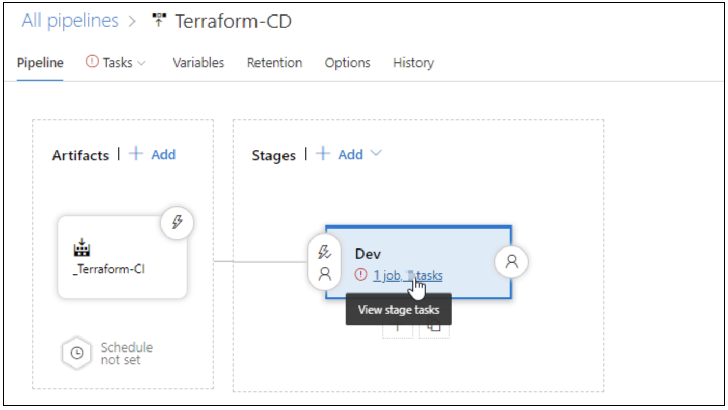
Azure Pipeline – CI/CD setup

Slide 34
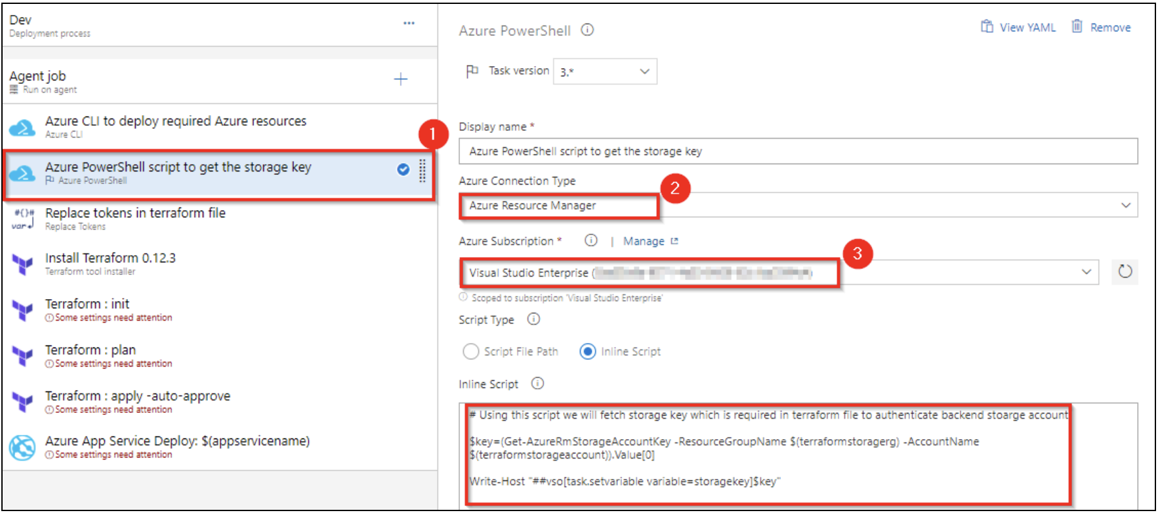
Azure Pipeline – CI/CD setup

Slide 35
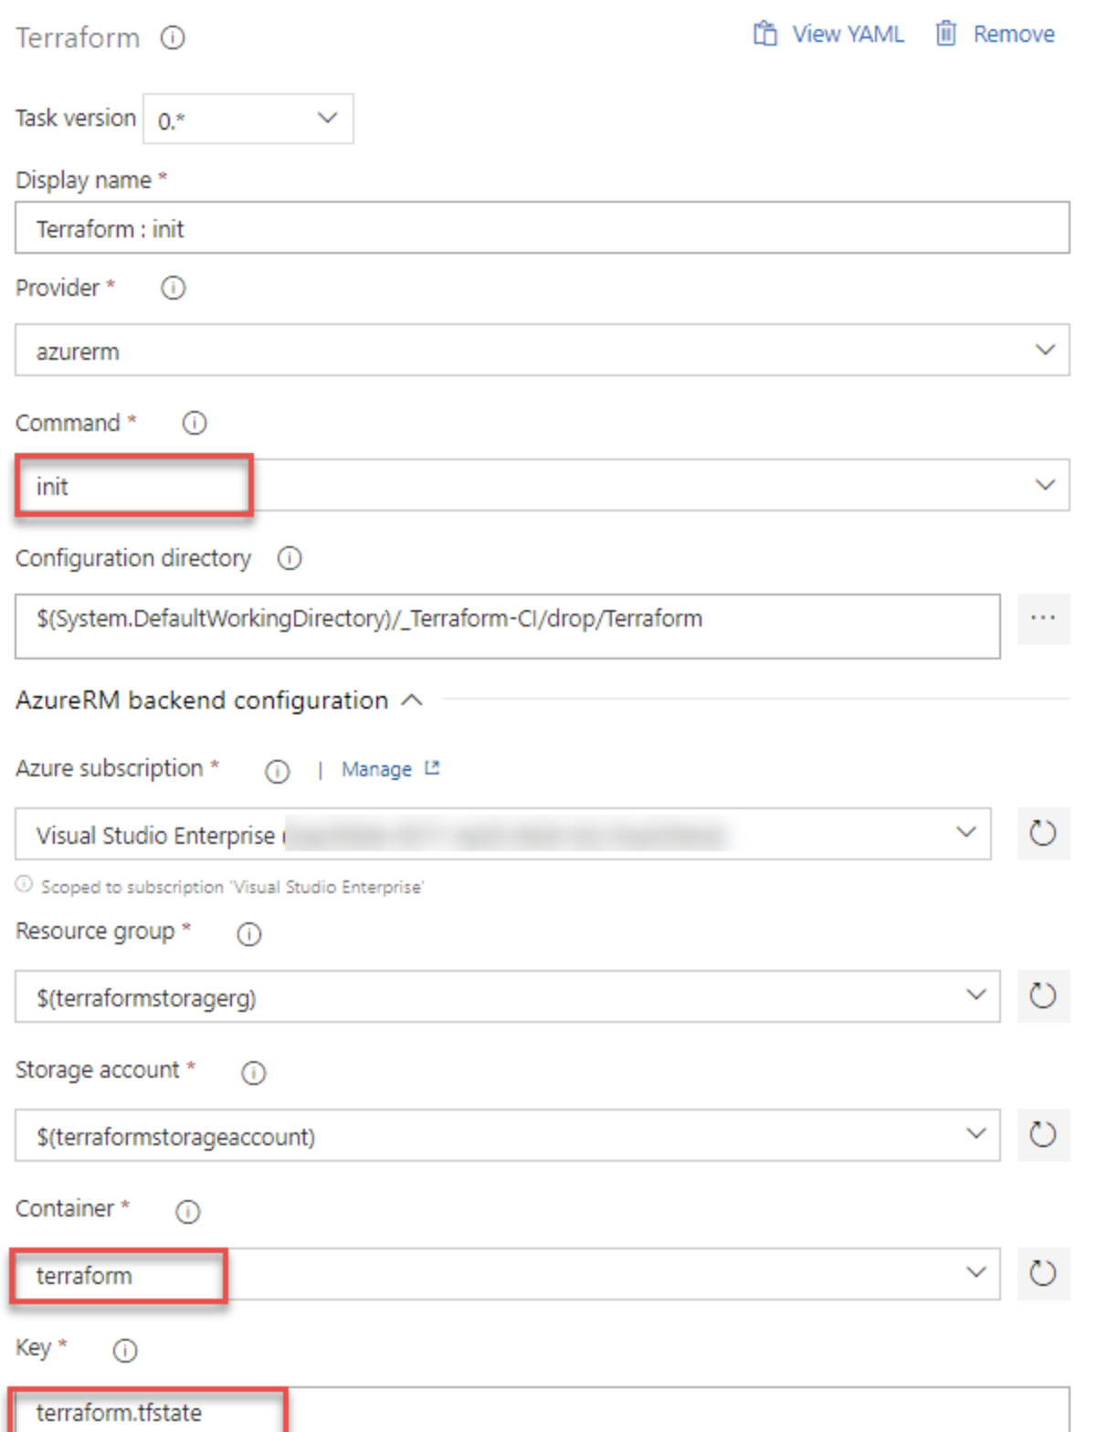
Azure Pipeline – CI/CD setup

Slide 36
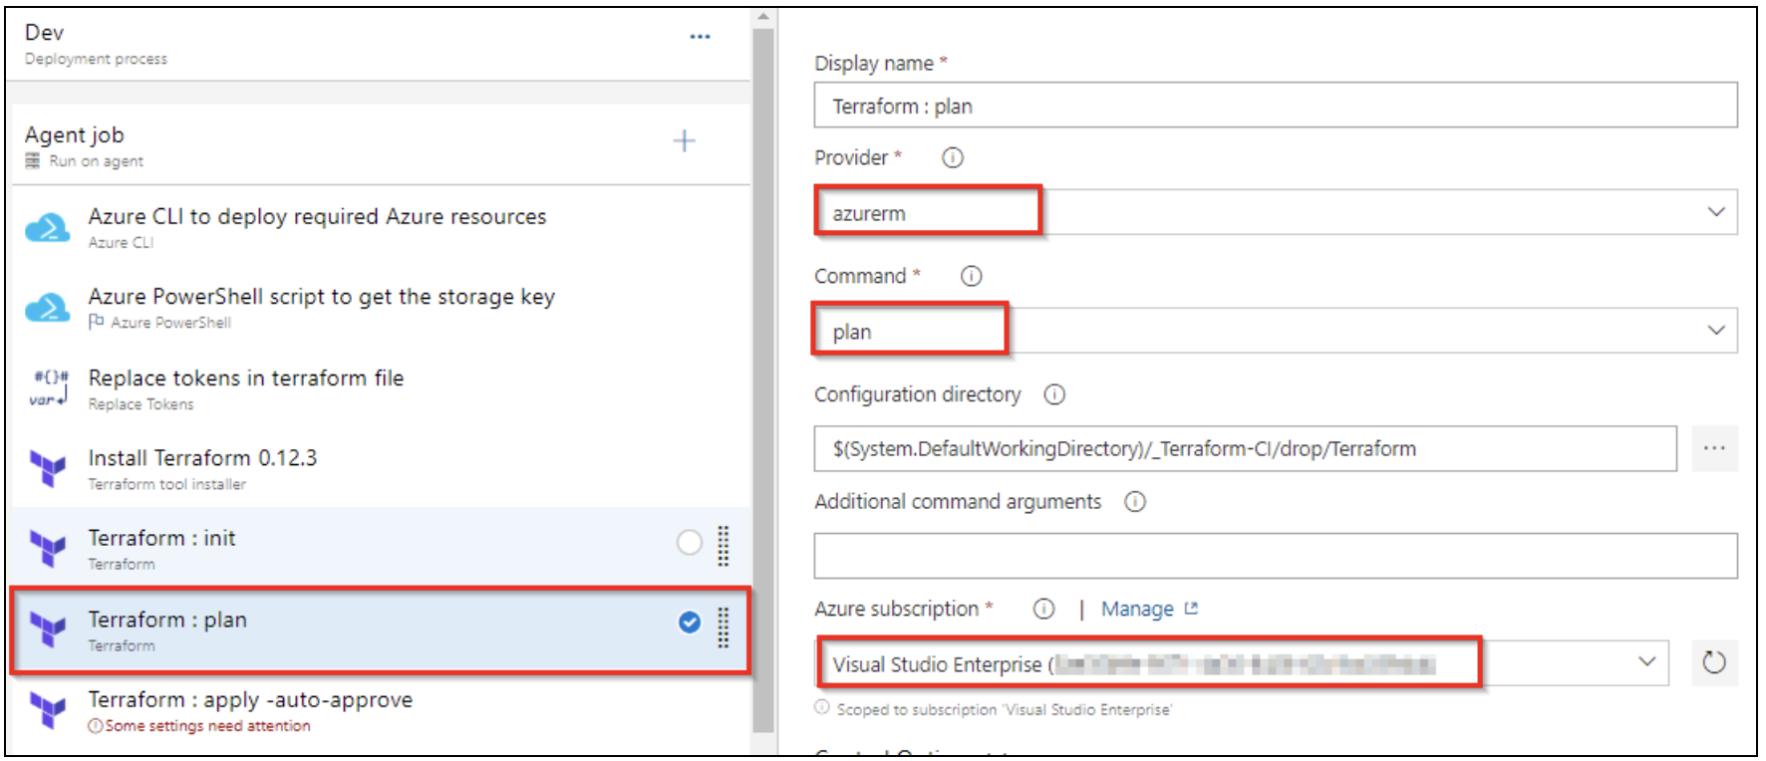
Azure Pipeline – CI/CD setup

Slide 37
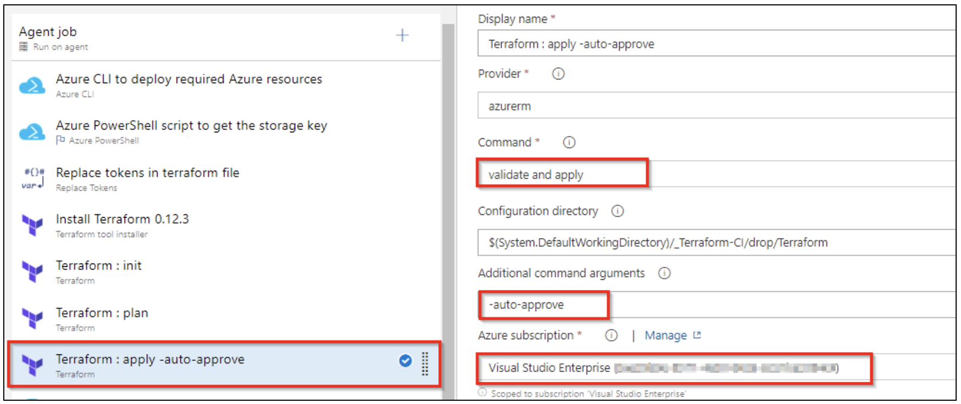
Azure Pipeline – CI/CD setup

Slide 38
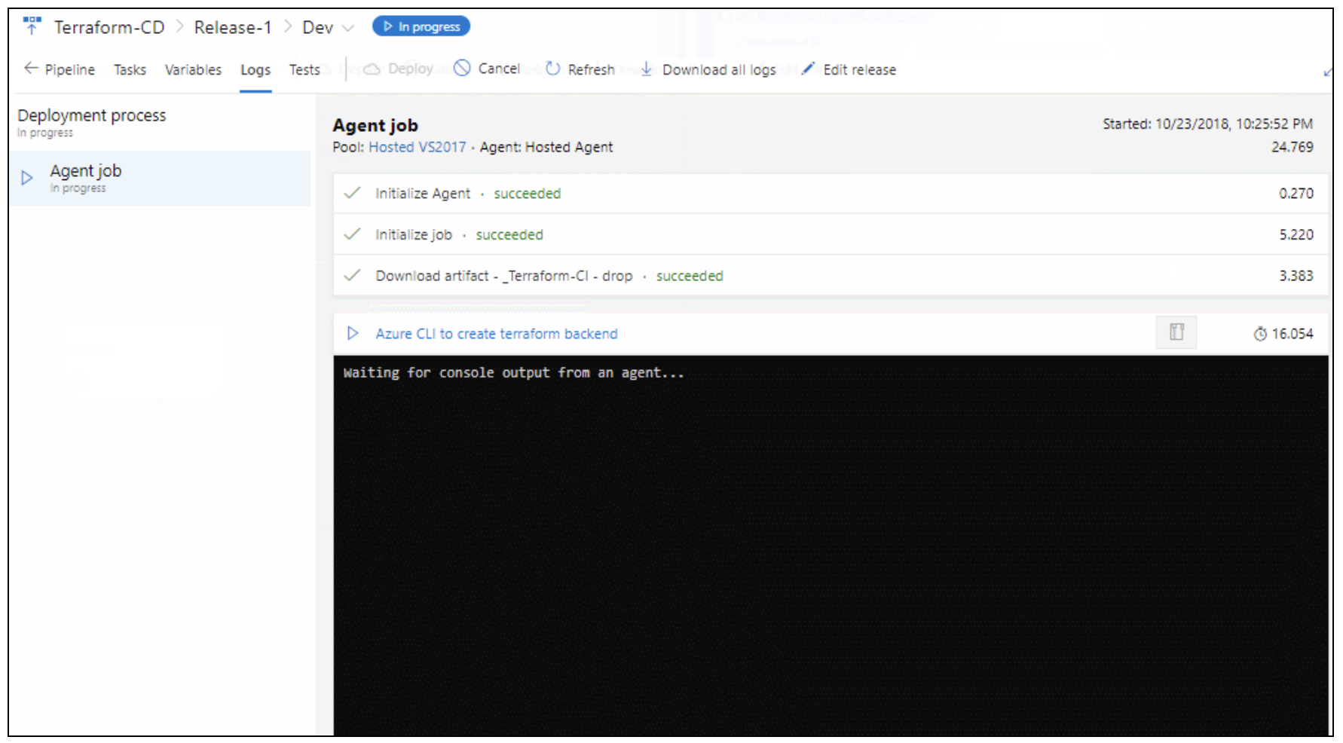
Azure Pipeline – CI/CD setup

Slide 39
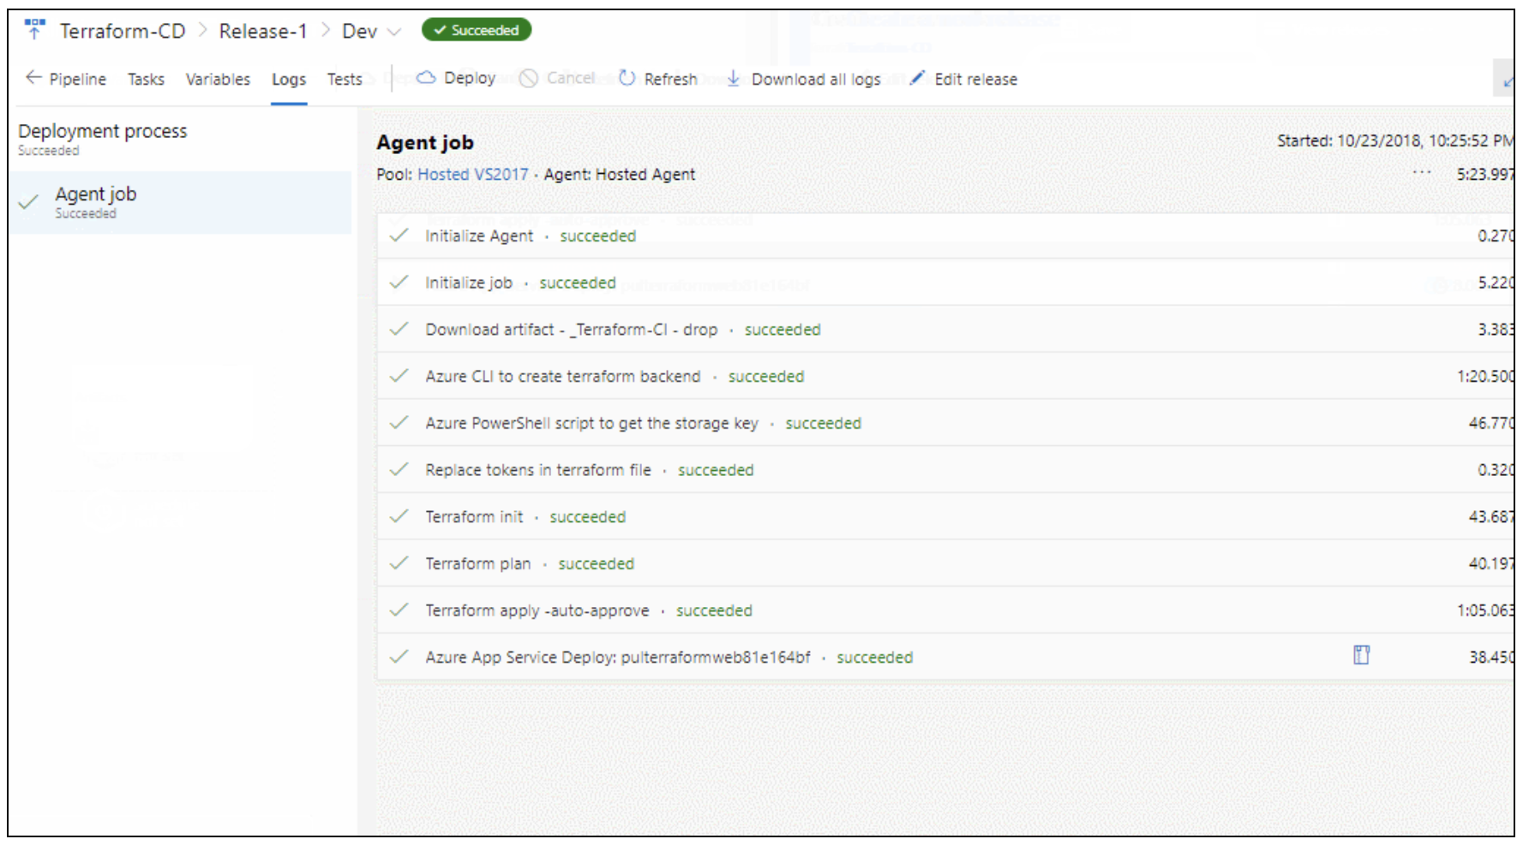
Azure Pipeline – CI/CD setup

Slide 40
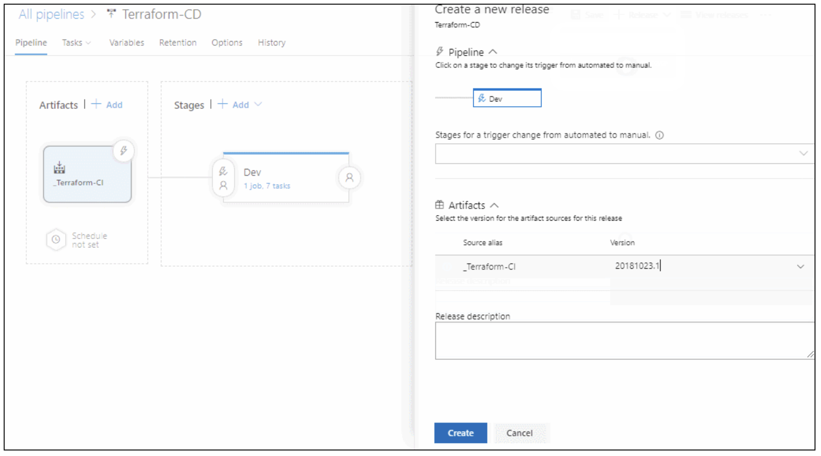
Azure Pipeline – CI/CD setup

Slide 41
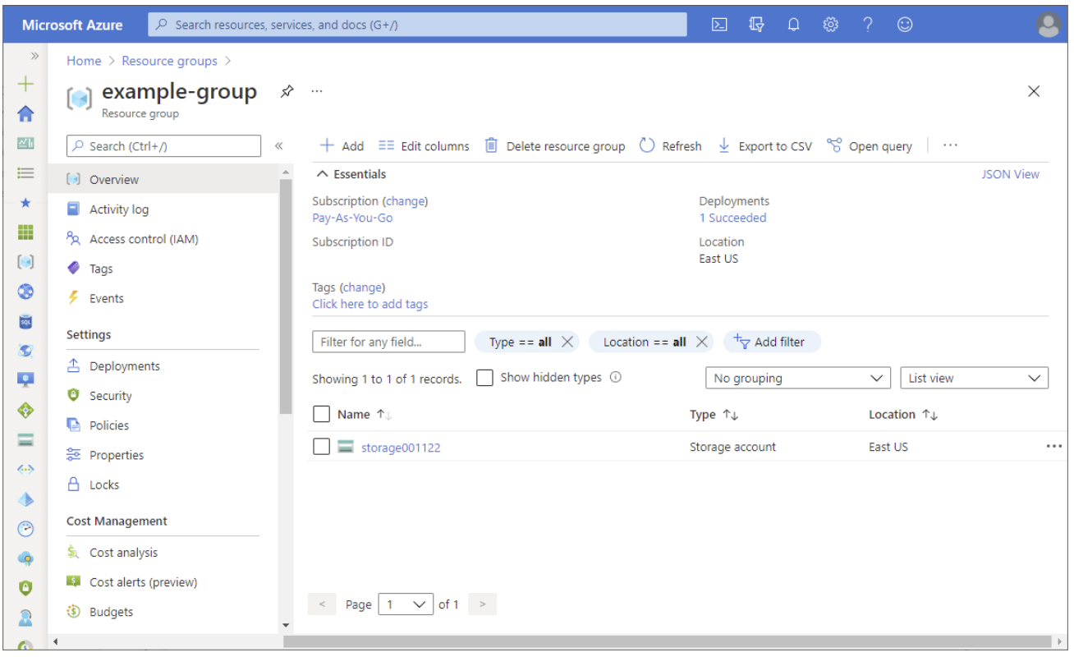
Microsoft Azure

Slide 42

Thank You

